Slide 1
Server-Side Local Gradient Averaging and Learning Rate Acceleration for Scalable Split Learning
*Shraman Pal¹, *Mansi Uniyal¹, Jihong Park^{2,4}, Praneeth Vepakomma³, Ramesh Raskar³, Mehdi Bennis⁵, Moongu Jeon⁴, Jinho Choi²
¹IIT Kharagpur, India, ²Deakin University, Australia, ³MIT Media Lab, USA, ⁴GIST, Korea, ⁴University of Oulu, Finland
*Equal contribution
Notes:
30sec

Slide 2
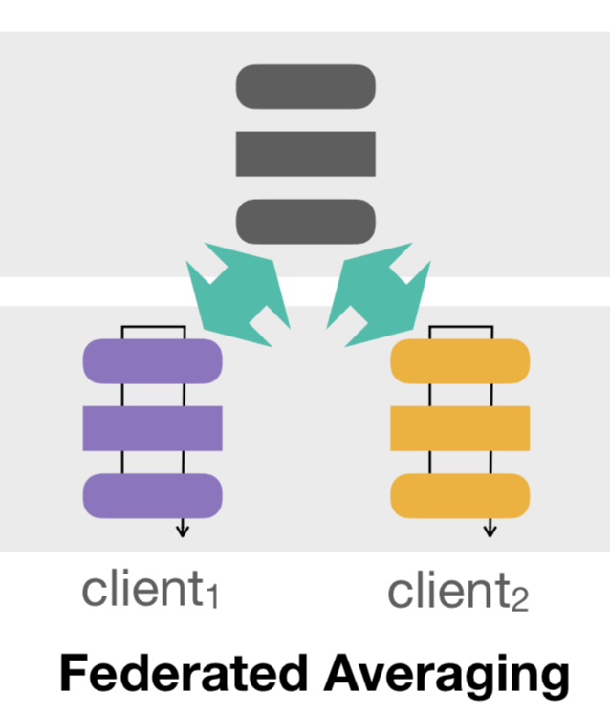
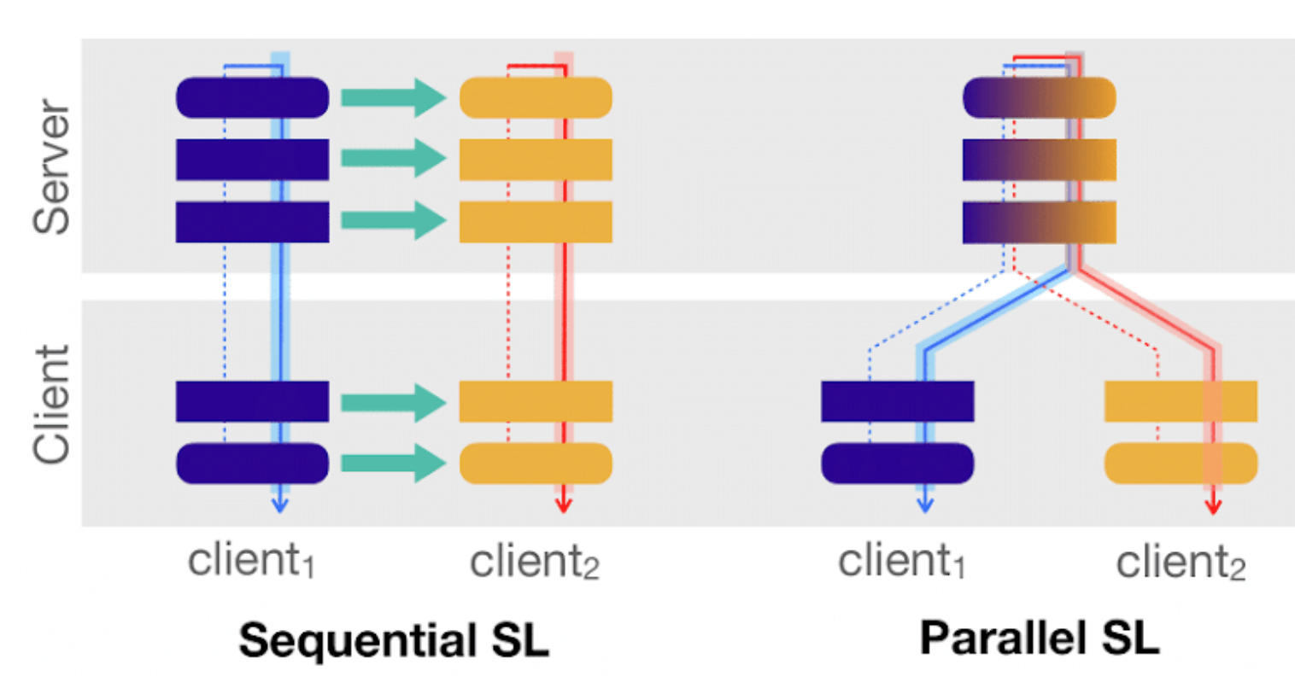
Federated Learning vs. Split Learning
Scalable systems show improved accuracy with the number of clients.
 | FedAvg | Sequential SL | Parallel SL
Large Models | X | ✔ | ✔
Many Clients | ✔ | X | ✔
Scalability | ✔ | ✔ | X
Notes:
1min (Total 1.5 mins) intro

Slide 3
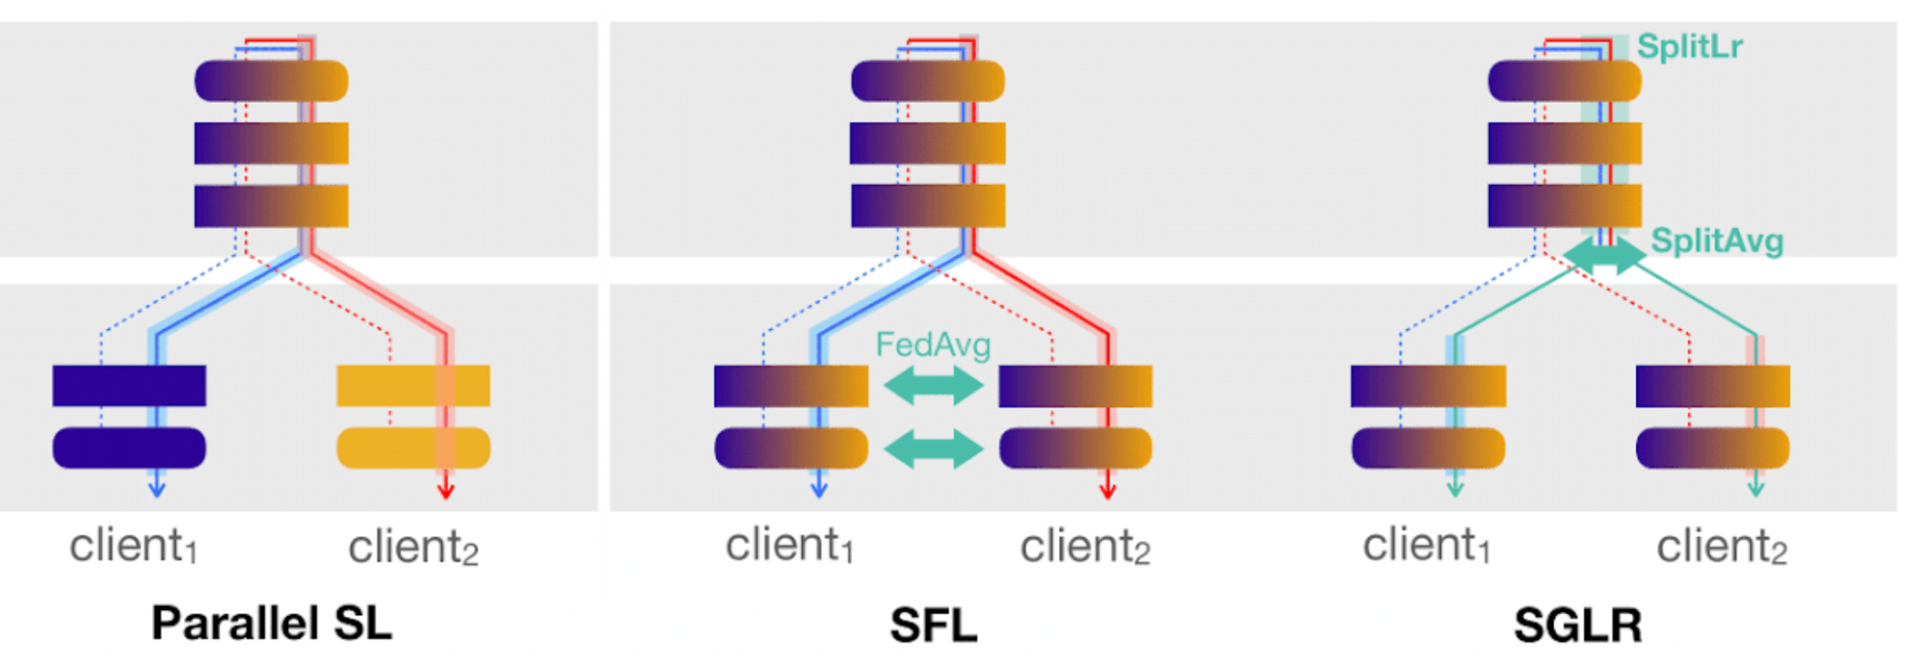
Towards Scalable Parallel Split Learning
1
1
2
2
Server client imbalance
1
SplitLr
1
Not scalable
Scalable
Server client detachment
SplitAvg
2
2
Notes:
Problems 1min Total 2.5 mins

Slide 4



SplitLr: Learning Rate Splitting
Learning rate schemes were based on the batch size:
SGD- linear scaling rule
Adam- square root scaling rate
Varying effective server batch size cause:
∴ Scaling ∝ number of clients
rather than the client batch size
α ε [0.0, 2.0], with a step size of 0.5
Proposed
Notes:
1 min (Total 3.5 mins)

Slide 5
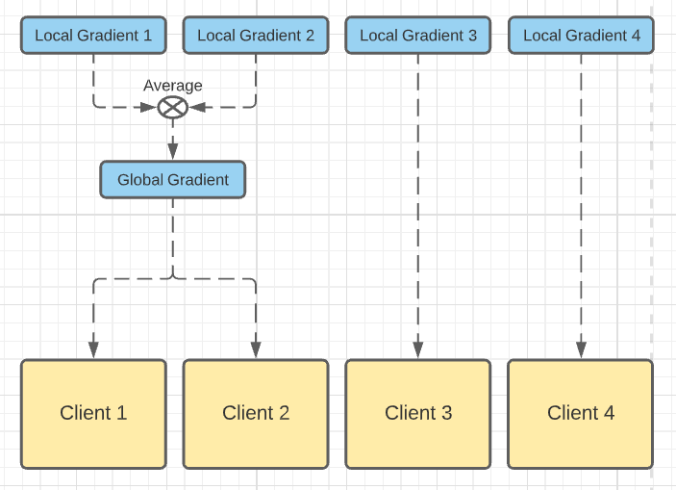
SplitAvg: Split-Layer Gradient Averaging
Aggregate the local gradients of a subset of clients into a global gradient.
Use of global gradient inplace of local gradients for the subset of clients.
Infuses information of one client to another during the backward pass.
∴ Solving backward client decoupling problem.
SplitAvg Diagram
Notes:
1 min (Total 4.5 mins)

Slide 6
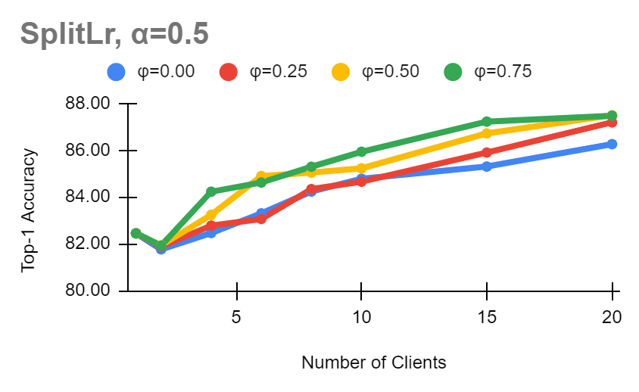
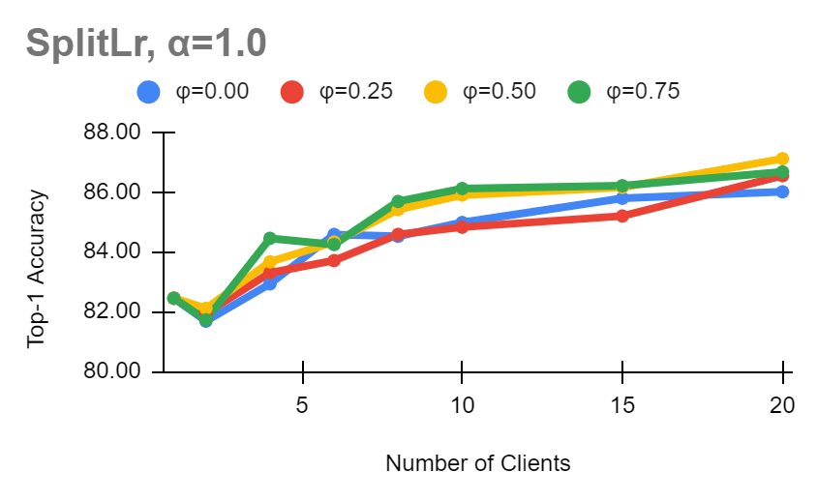
Top-1 Accuracy: Scalability
Accuracy on FashionMNIST for different settings of SGLR
With increase in number of clients: low value of φ, keeps number of active clients in a suitable range
For 20 Clients
 | Baseline | SplitAvg(φ=0.5) | SplitLr(α= 0.5)
Score | 84.88 | 86.59 | 87.48
% Increase | - | +1.71 | +0.89
Notes:
1 min (Total 5.5 mins)

Slide 7
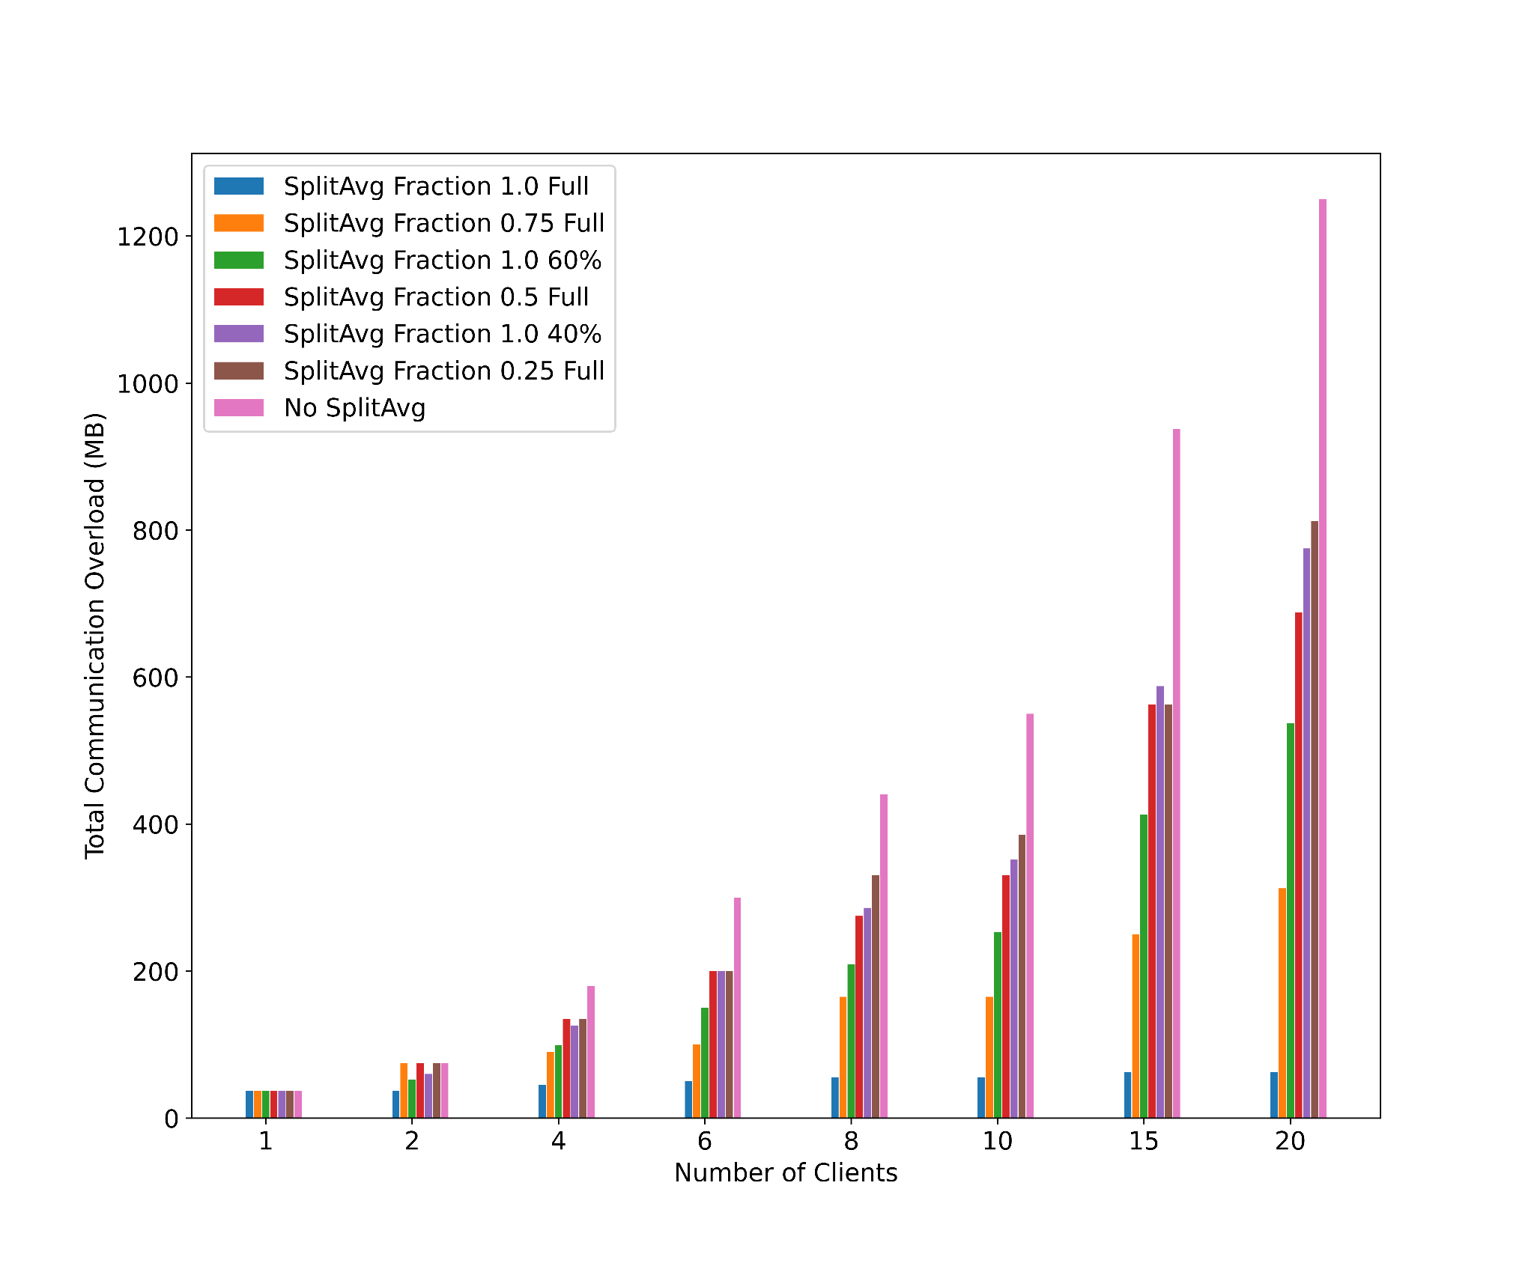
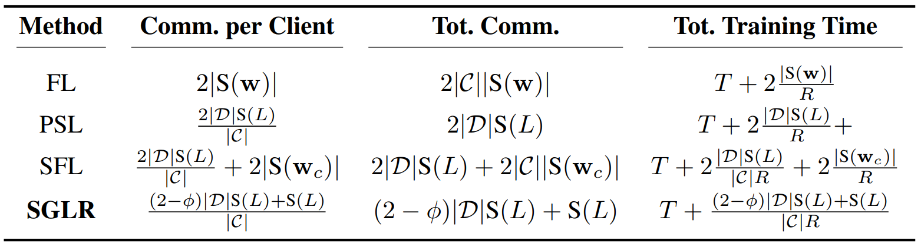
Communication Efficiency
Communication overhead and training time analysis of the different methods
For different variations of SplitAvg:
Fraction=1.0 gives highest efficiency.
Smaller fraction has higher efficiency over phased training.
{when number of clients are high}
Notes:
30 sec Total 6 mins

Slide 8
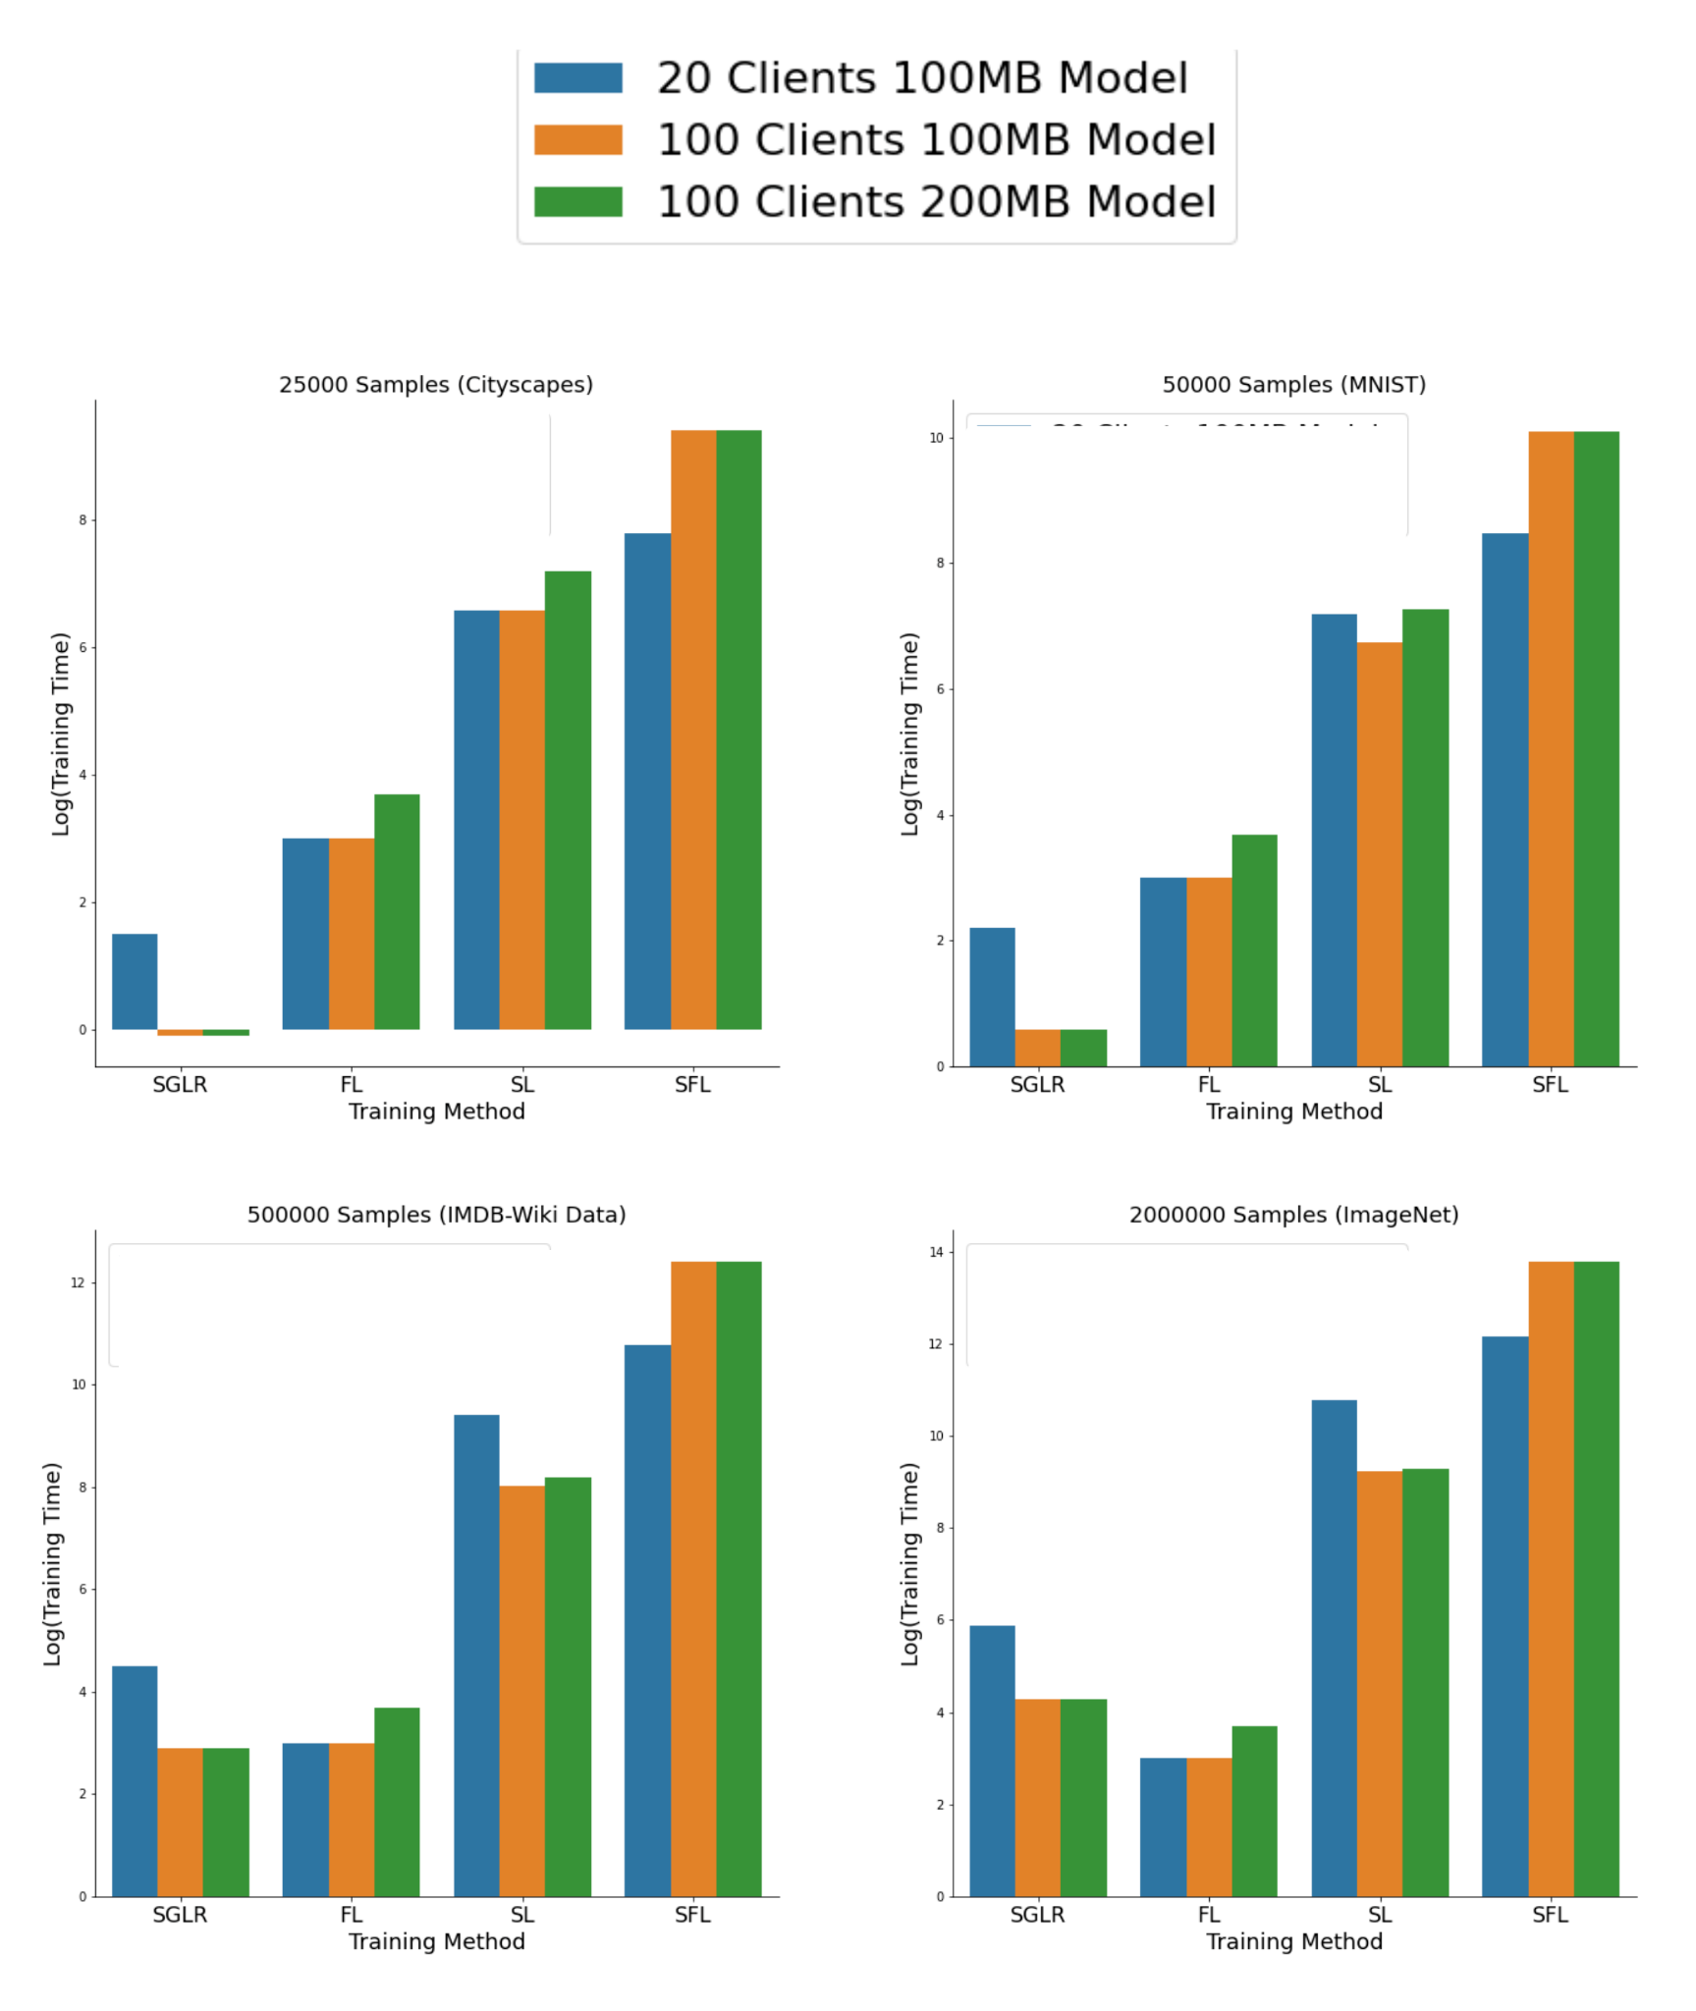
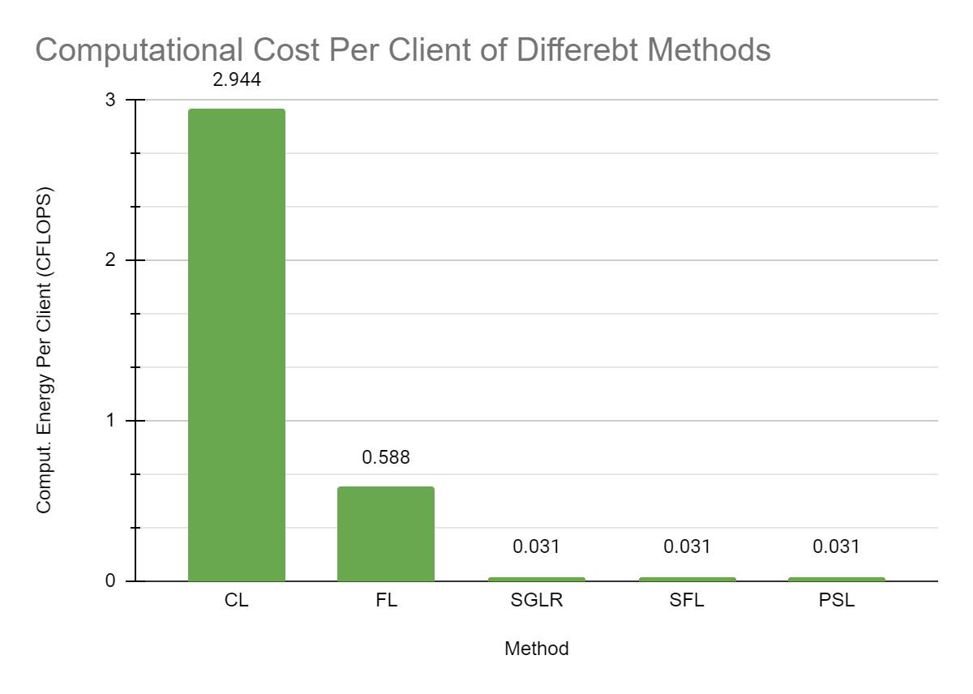
Training Time
Computational Cost Per Client (CFLOPS)
Notes:
45 sec (6.75 min)

Slide 9
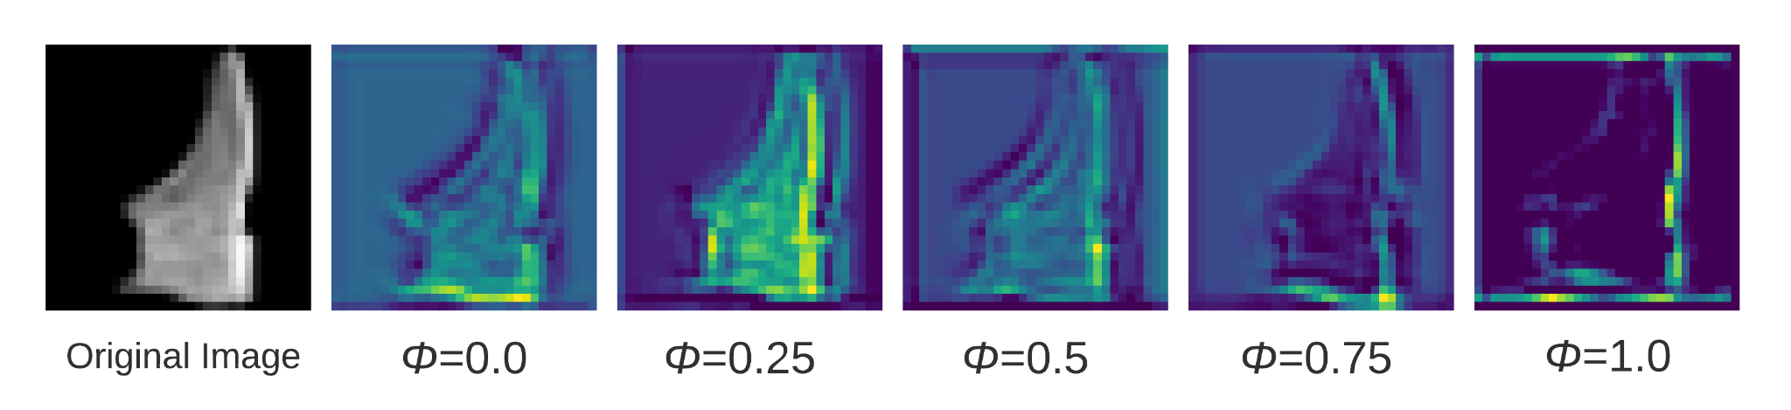
Information Leakage
Fraction | 0.00 | 0.25 | 0.50 | 0.75 | 1.00
Loss | 0.2153 | 0.2142 | 0.2166 | 0.2296 | 0.2759
Information Leakage is reduced by increasing number of clients whose local gradients are aggregated.
A reconstruction loss has been computed as a proxy.
Notes:
30 sec Total 7.25 mins

Slide 10
Conclusion
Future Works
Proposed scalable SL framework SGLR laid by SplitLr and SplitAvg addresses the server-side large batch problem and the backward client decoupling problem, respectively.
Less information leakage
Higher communication efficiency
than the standard parallel SL
Extending SplitLr: cyclic learning rate splitting method
Convergence Analysis
Differential Privacy Analysis
on SplitAvg
Notes:
45 sec (Total 8 mins)

Slide 11
References
Alom, M. Z.; Taha, T. M.; Yakopcic, C.; Westberg, S.; Sidike, P.; Nasrin, M. S.; Esesn, B. C. V.; Awwal, A. A. S.; and Asari, V. K. 2018. The History Began from AlexNet:
A Comprehensive Survey on Deep Learning Approaches. arXiv:1803.01164.
Brown, T. B.; Mann, B.; Ryder, N.; Subbiah, M.; Kaplan, J.; Dhariwal, P.; Neelakantan, A.; Shyam, P.; Sastry, G.; Askell, A.; Agarwal, S.; Herbert-Voss, A.; Krueger, G.; Henighan, T.; Child, R.; Ramesh, A.; Ziegler, D. M.; Wu, J.; Winter, C.; Hesse, C.; Chen, M.; Sigler, E.; Litwin, M.; Gray, S.; Chess, B.; Clark, J.; Berner, C.; McCandlish, S.; Radford, A.; Sutskever, I.; and Amodei, D. 2020. Language Models are Few-Shot Learners. arXiv:2005.14165.
Dario Amodei, D. H. 2018. AI and Compute. https://openai.com/blog/ai-and-compute/. Accessed: 2021-11-30.
Devlin, J.; Chang, M.-W.; Lee, K.; and Toutanova, K. 2019. BERT: Pre-training of Deep Bidirectional Transformers for Language Understanding. arXiv:1810.04805.
Falcon, W.; and Cho, K. 2020. A Framework For Contrastive Self-Supervised Learning And Designing A New Approach. arXiv preprint arXiv:2009.00104.
Geiping, J.; Bauermeister, H.; Droge, H.; and Moeller, M. 2020. Inverting Gradients – How easy is it to break privacy in federated learning? arXiv:2003.14053.
Goyal, P.; Dollar, P.; Girshick, R.; Noordhuis, P.; Wesolowski, L.; Kyrola, A.; Tulloch, A.; Jia, Y.; and He, K. 2018. Accurate, Large Minibatch SGD: Training ImageNet in 1 Hour. arXiv:1706.02677.
Gupta, O.; and Raskar, R. 2018. Distributed learning of deep neural network over multiple agents. arXiv:1810.06060.
He, K.; Zhang, X.; Ren, S.; and Sun, J. 2015. Deep Residual Learning for Image Recognition. arXiv:1512.03385.
Huang, G.; Liu, Z.; van der Maaten, L.; and Weinberger, K. Q. 2018. Densely Connected Convolutional Networks. arXiv:1608.06993.
Kingma, D. P.; and Ba, J. 2017. Adam: A Method for Stochastic Optimization. arXiv:1412.6980.
Krizhevsky, A. 2014. One weird trick for parallelizing convolutional neural networks. arXiv:1404.5997.
McMahan, H. B.; Moore, E.; Ramage, D.; and y Arcas, B. A. 2016. Federated Learning of Deep Networks using Model Averaging. ArXiv, abs/1602.05629.
Park, J.; Samarakoon, S.; Bennis, M.; and Debbah, M. 2019. Wireless Network Intelligence at the Edge. Proceedings of the IEEE, 107(11): 2204–2239.
Park, J.; Samarakoon, S.; Elgabli, A.; Kim, J.; Bennis, M.; Kim, S.; and Debbah, M. 2021. Communication-Efficient and Distributed Learning Over Wireless Networks: Principles and Applications. Proceedings of the IEEE, 109(5): 796–819.
Simonyan, K.; and Zisserman, A. 2015. Very Deep Convolutional Networks for Large-Scale Image Recognition. arXiv:1409.1556.
Smith, S. L.; Kindermans, P.-J.; Ying, C.; and Le, Q.V. 2018. Don’t Decay the Learning Rate, Increase the Batch Size. arXiv:1711.00489.
Szegedy, C.; Vanhoucke, V.; Ioffe, S.; Shlens, J.; and Wojna, Z. 2015. Rethinking the Inception Architecture for Computer Vision. arXiv:1512.00567.
Thapa, C.; Chamikara, M. A. P.; Camtepe, S.; and Sun, L. 2021. SplitFed: When Federated Learning Meets Split Learning. arXiv:2004.12088.
Vepakomma, P.; Gupta, O.; Swedish, T.; and Raskar, R. 2018. Split learning for health: Distributed deep learning without sharing raw patient data. arXiv:1812.00564.
Wang, Y.; Ni, Z.; Song, S.; Yang, L.; and Huang, G. 2021. Revisiting Locally Supervised Learning: an Alternative to End-to-end Training. In International Conference on Learning Representations.
Xiao, H.; Rasul, K.; and Vollgraf, R. 2017. Fashion-MNIST: a Novel Image Dataset for Benchmarking Machine Learning Algorithms. arXiv:1708.07747.
Zhang, M.; Wei, E.; and Berry, R. 2021. Faithful Edge Federated Learning: Scalability and Privacy. arXiv:2106.15905.

